Slide 1

RideAustin: Predicting Hotspots
By Will Johnson

Slide 2
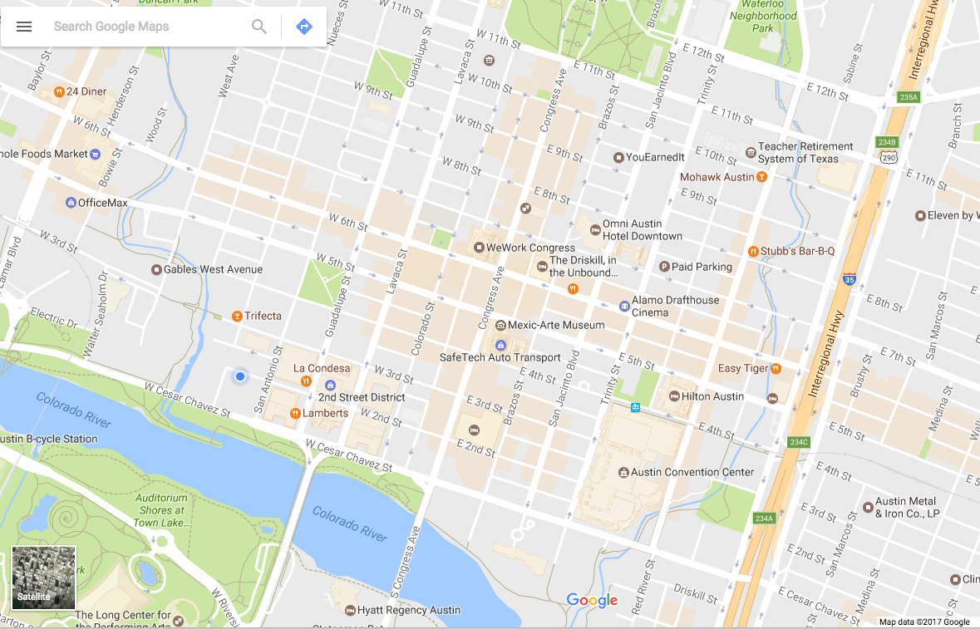
April 13th, 2017

Slide 3
NO DRIVER AVAILABLE

Slide 4

Goal:
Dataset:
Bring the Drivers to the Riders

Slide 5
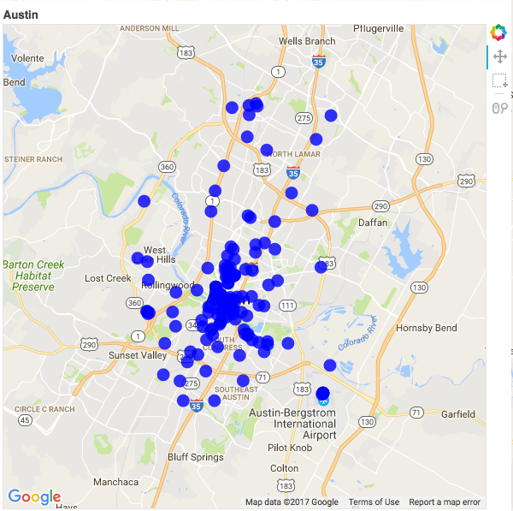
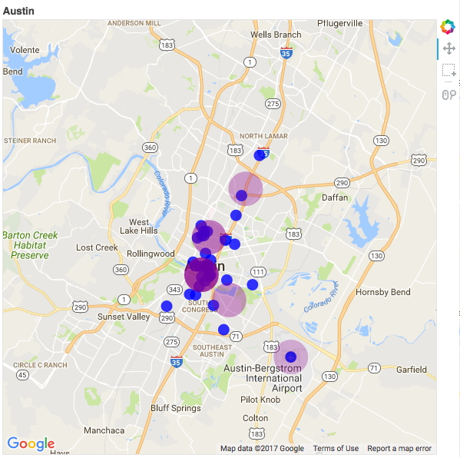
Input
Output
Historical Requests
Sundays 10:00pm - 10:30pm
April 13th, 2017
10:00pm - 10:30pm
* Bokeh

Slide 6
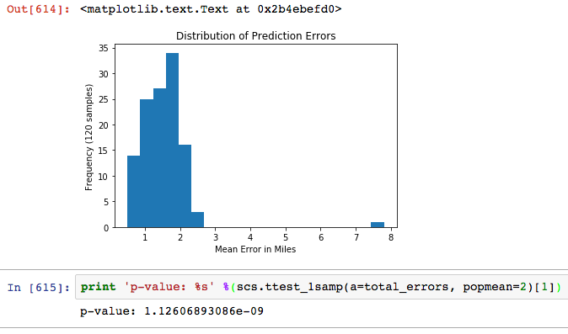
Results!
Mean Absolute Error
in miles
Avg < 2 miles
* Matplotlib

Slide 7
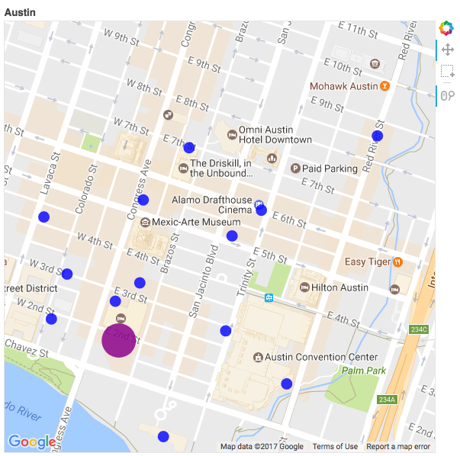

Actual Rides vs. Hotspot Prediction

Slide 8
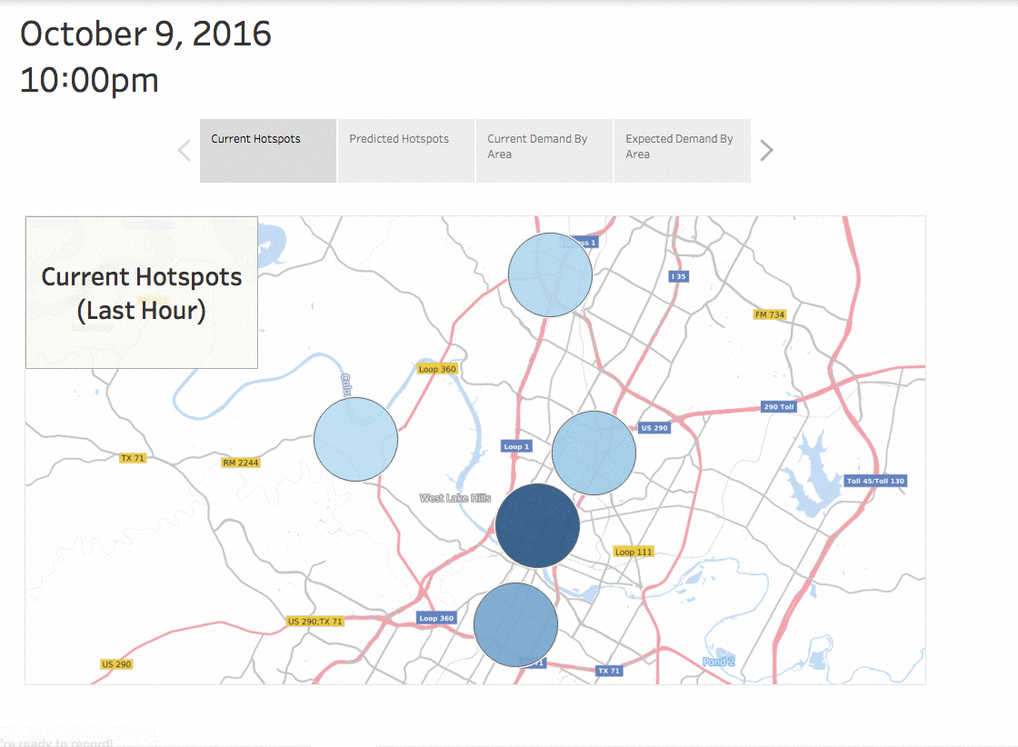
App in Action:
Current Hotspots
* Tableau

Slide 9
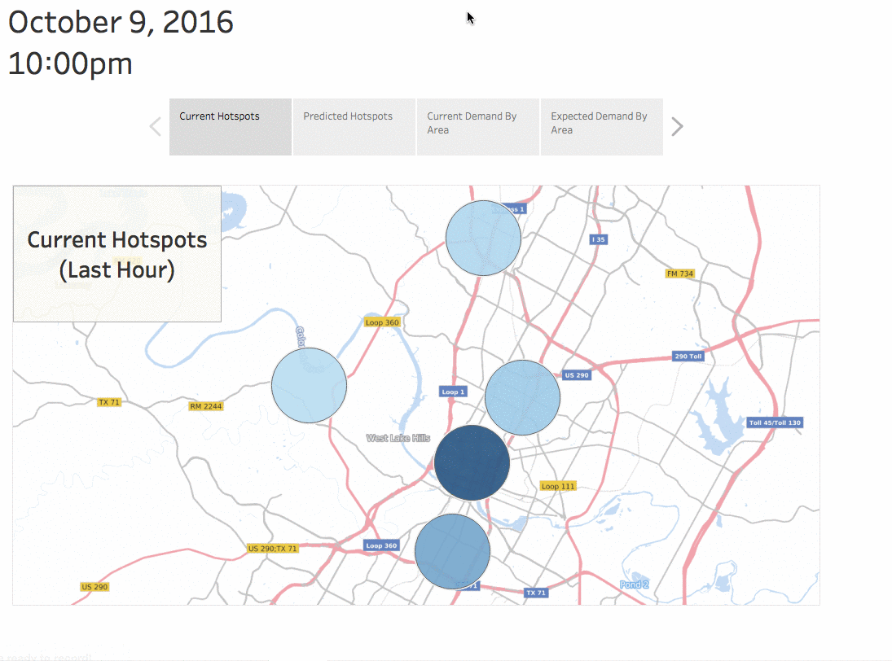
App in Action:
Predicted Hotspots
* Tableau

Slide 10
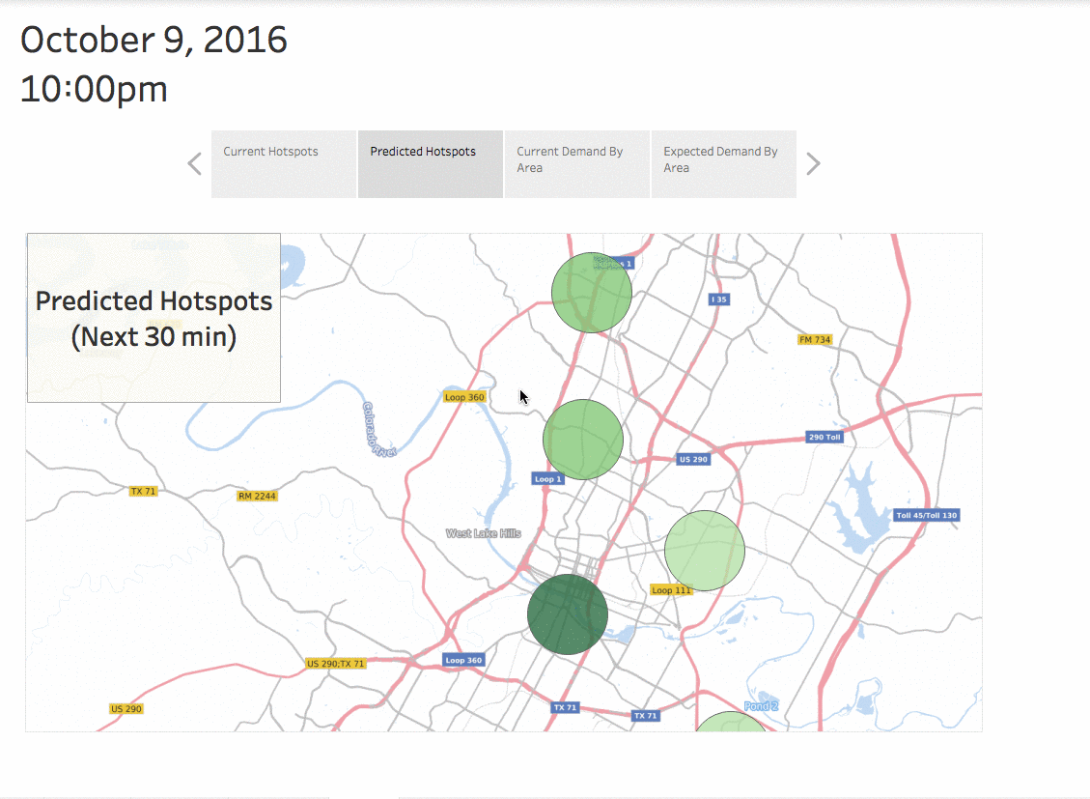
App in Action:
Current
by area
* Tableau

Slide 11
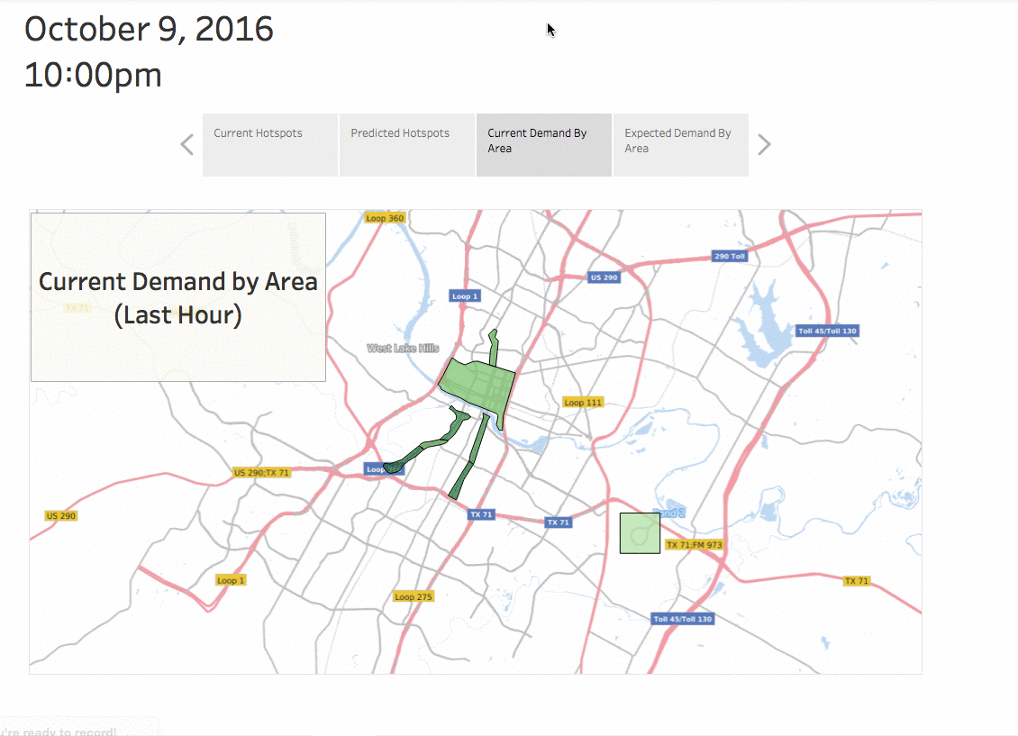
App in Action:
Predictions
by area
* Tableau

Slide 12



Will Johnson
Thank you!
: github.com/Johnsoneer
linkedin.com/in/iamwilljohnson/
iam.will.johnson@gmail.com
Special thanks to RideAustin and Tableau!

Slide 13
Appendix A
Limitations:
Requires high-volume
Lat-Long not always on streets
Herd Behavior Effect

Slide 14
Appendix B
Next Steps:
Weather Data
Flight Information
Real-time Geolocation Data

Slide 15
Tools Used:
Programming:
Python:
Numpy
Pandas
Sklearn
Scipy.Stats
MySQL
Frequentist Hypothesis Testing
Appendix C
Supervised Machine Learning:
RandomForestRegressor
Linear Regression
Unsupervised Learning:
K-Means Clustering
Visualization Libraries:
Matplotlib
Bokeh
Tableau

Slide 16
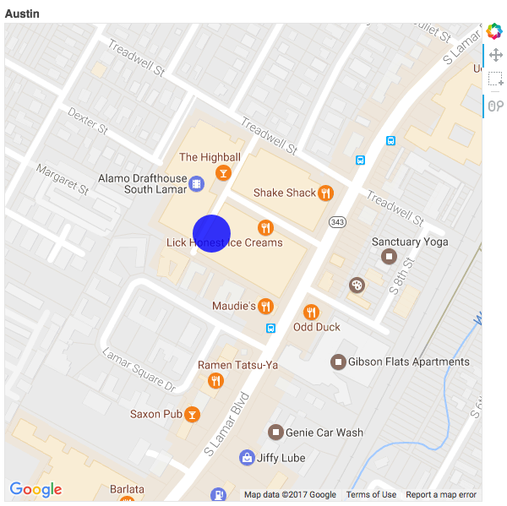
Step 1:
Choose a Ride Request
* Bokeh

Slide 17
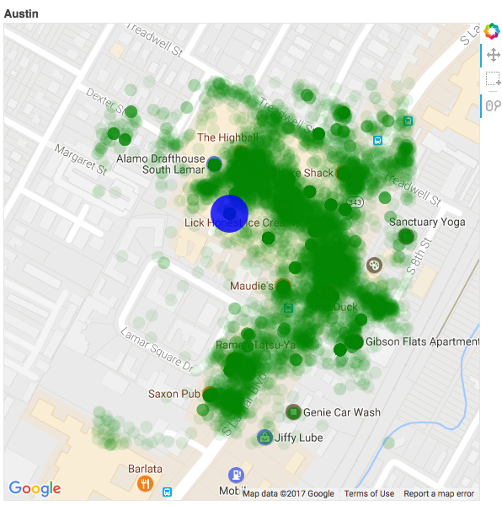
Step 2:
Find Similar Rides
* Bokeh

Slide 18
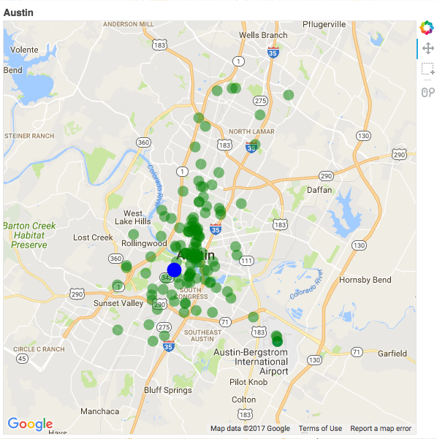
Step 3:
Find Following Rides
* Bokeh

Slide 19
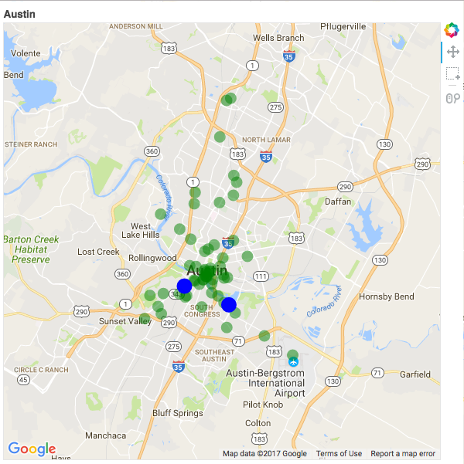
Step 4:
Random Sample
* Bokeh

Slide 20
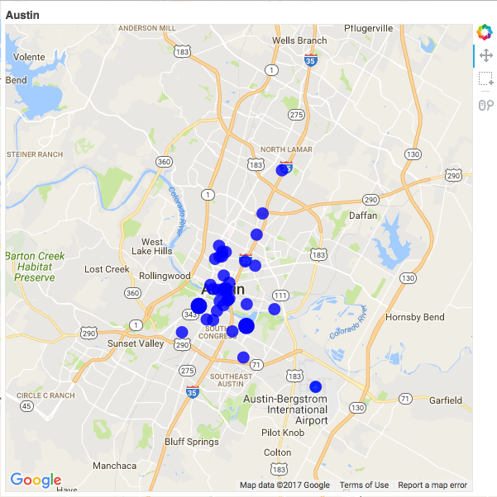
Step 5:
Repeat!
Predicted Rides
* N repetitions from Random Forest Regressor
* Bokeh

Slide 21
Step 6:
Create Predicted Hotspots
Predicted Hotspots
* Hotspots = Centroids in K-Means Clustering
* Bokeh

